Slide 1
What is AS/A2 Moving Image Art?

Slide 2
The Moving Image Arts course is……
The study and practice in filmmaking industry conventions
you will be given the opportunity to develop creativity, knowledge and skills in the production of your own film portfolios.
You will study a wide range of films and practitioners throughout different eras to inform your own ideas
You will acquire industry skills in screen-writing, directing, camera work, lighting, production design, editing and sound
You will create detailed, illustrated evidence of your research, planning and design work.
A joint course with Kilkeel High at AS/A Level
A course that is offered at many Universities as e.g. Film Studies

Slide 3
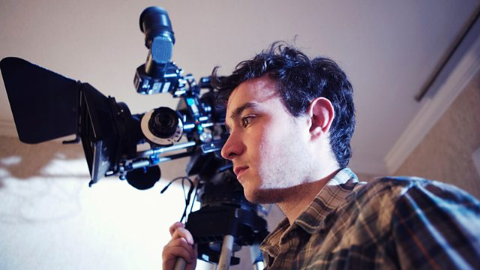
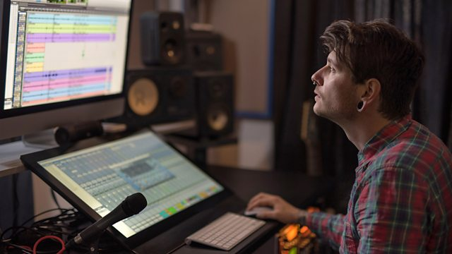
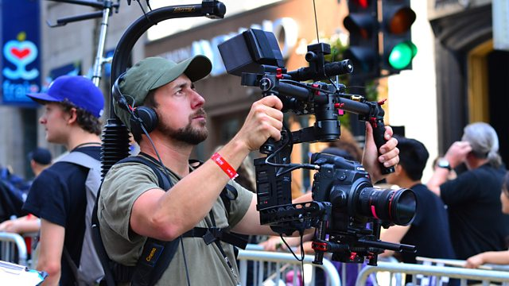
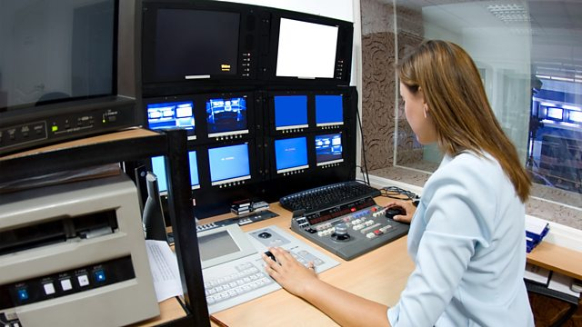
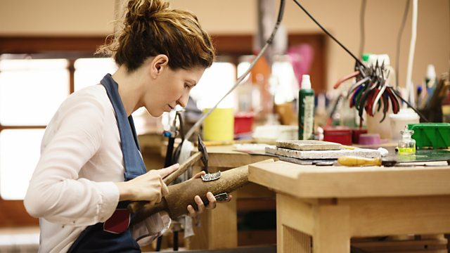
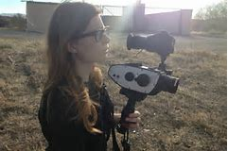
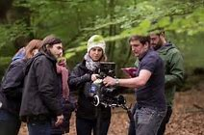
What can I do with a qualification in Moving Image Arts?
Camera operator
Director
Sound designer
Editor
The rapid growth of digital and online media means that there is great demand for moving image content worldwide and increasingly in Ireland e.g. Game of Thrones, Derry Girls
Opportunities not only in the film, TV and gaming industries
but also in a wide number of other areas, including PR, marketing, advertising and journalism.
Producer
Production designer
Cinematographer
Director of photography

Slide 4
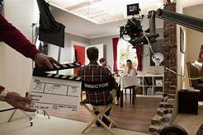
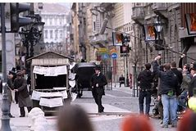
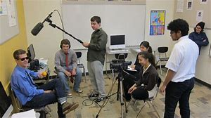
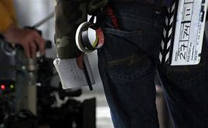
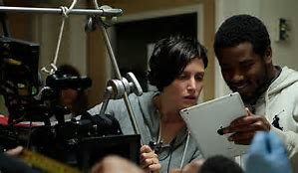
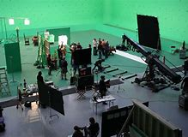
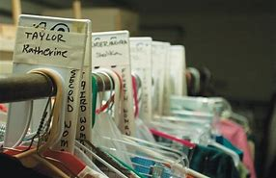
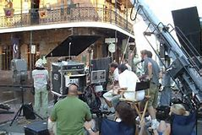
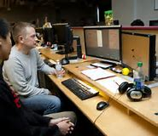
Employability Key Skills & Qualities
Moving Image Arts provides a range of practical, transferable
skills, the type of skills every employer looks for;
the ability to come up with ideas
to problem-solve
to be able to work in a team
to meet deadlines
to be self-motivated and
to be able manage a project successfully from start
to completion

Slide 5
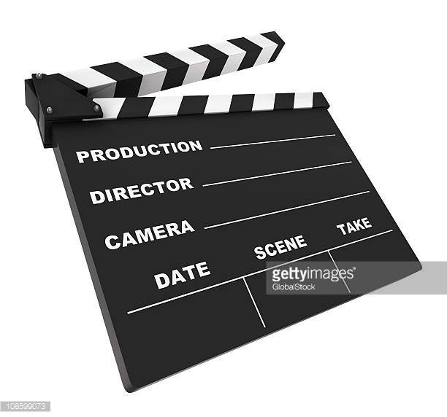
In the study of Moving Image you should gain understanding of 5 film language areas:
camera; how it moves and purpose
editing; types and purpose
sound; types and purpose
lighting; types and purpose
mise-en-scène. purpose
And knowledge of
Film Genre
live-action film, which refers to live-action fictional narrative films; and
animated film, which refers to rostrum, stop-motion and computer-generated imagery (CGI) animated narrative films.

Slide 6
AS
2000-2700 words
20-30 A4 pages aprox. visual and written work

Slide 7
Online Mock Exam in Term 2: January/ February
Online Exam takes place in school in Term 3 April/May

Slide 8
A2
2000-2700 words
20-30 A4 pages
The Online Exam will test knowledge of film language, era’s, genres from AS andA2
Mock term 2: January Online Exam Term3 May/June

Slide 9
MIA is not for…..
Students who fancy having a go with a camera and think it can be completed in a weekend
Students who believe that Moving Image Arts is about watching films
Students who thinks you will be writing less- you will be analysing film in as much detail as you study a novel!
Students who thinks that making a film or using editing software is easy.

Slide 10
MIA is for …….
Film enthusiasts who genuinely enjoy film and want to learn more
Student who what to learn about practical film making industry conventions
the theoretical side of film-making.
Students who understand that there is a lot of work to do with film theory.
Creative and hardworking students who realise that there will be quite a bit of writing to do.

Slide 11
Any further Questions?

